Slide 1


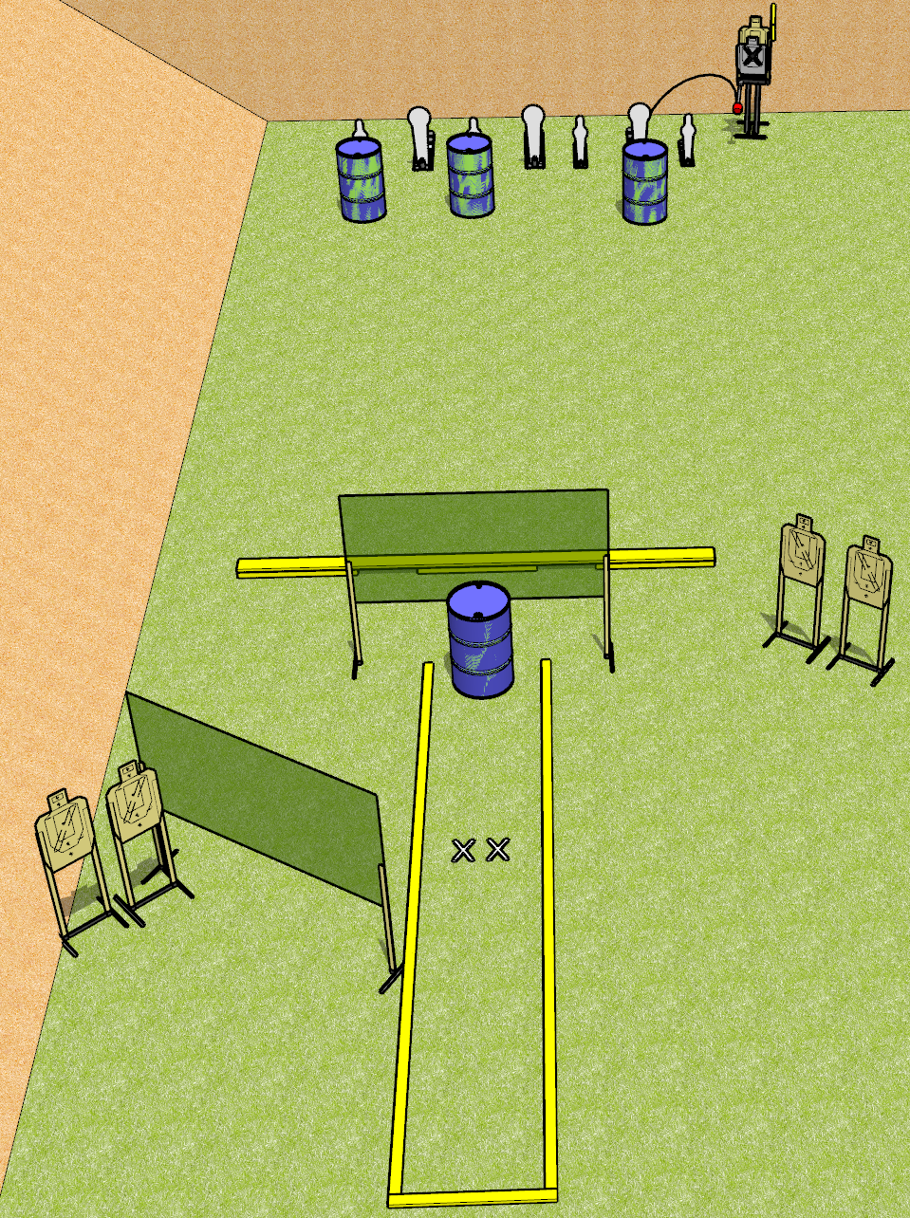
 | Dothan Gun Club – USPSA Match Tea @ 1 Course Designer : Drew Coleman
START POSITION : Standing with both feet heels on X’s
GUN READY CONDITION : Firearm unloaded on barrel. Mags must be on belt. |  | SCORING: Comstock, 12 rounds TARGETS: 5 paper, 7 Steel SCORED HITS: Best 1 on paper, steel until down START-STOP: Audible, last shot RULES:
STAGE PROCEDURE: Engage targets as they become available from within the fault lines

